Slide 1

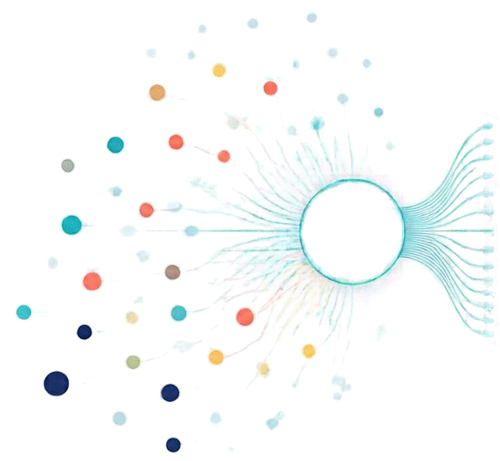
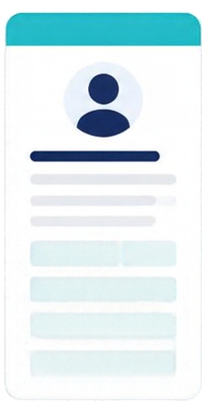







AI-Powered
Lead Classification & Automation System
Transforming Customer Enquiries into Actionable Sales Leads
From scattered enquiries to organized sales leads
High Intent
Automation Tools
Presented by
Ramesh Kumar
New Lead
Company
MOTI PACKAGING

Slide 2












Project Introduction —
Structured Lead Record
Turning scattered enquiries into structured, actionable leads
Name
Acme Solutions
Contact
Jordan Lee
Whatsapp
Hi, I need pricing for your product. Our team is 25 people. Please share a demo.
Email
jordan.lee@acmesolutions.com
Company Size
25 people
Interest
Packaging
Interested in your solution for our company. Budget around $20k. Let's connect next week.
Email
Budget
Around $20k
Next Step
Sample next week
We’re looking for automation tools to handle more leads.
Can this integrate with CRM?
Source
Whatsapp, Email, Live Chat
Live
Chat
Status
New Lead
Different sources. Different formats. One clear opportunity.
Ready for Sales Follow-Up

Slide 3















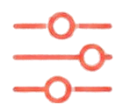
The Current Challenge
Why turning enquiries into sales-ready leads is still difficult
1
2
3
4
5
Enquiries are spread across sources
Customer details are unstructured
Product needs may be unclear
Manual sorting takes time
Follow-ups are harder to track
Information arrives
from many channels
in different formats.
Key data is incomplete or inconsistent, making it hard
to use.
Enquiries often lack context, intent,
or buying signals.
Teams spend hours reviewing and routing leads by hand.
Important leads
get missed or lose momentum.

Slide 4

















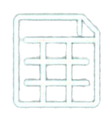






What the Project Aims to Do
Six clear enquiries that turn enquiries into actionable sales leads
1
2
3
4
5
6
Bring enquiries together
Extract customer and product details
Flag missing information
Use an LLM to classify enquiries
Save clean records in Google Sheets
Help the team
plan follow-ups
Capture enquiries from website forms, emails, and live chat in one place.
Pull key information like name, contact, company, interest, and budget.
Identify gaps in the enquiry so the team knows what to ask
next.
Understand intent and categorize enquiries to prioritize the right ones.
Store structured, consistent lead
data for easy access
and reporting.
Provide clear next
steps so the team
can engage with confidence.

Slide 5





What Each Lead Record Contains
Every lead is captured with the details your team needs to qualify, clarify, and act with confidence.
Customer Name
Contact
Product and
quantity
Delivery
location
Missing Fields
Application
BrightPath
Logistics
Sarah Mitchell
sarah.mitchell@brightpath.com
(555) 123-4567
8000 pieces
Greater Noida
Specific payload
capacity,width.
Jeans
Greenfield
Manufacturing
Michael Chen
michael.chen@greenfieldmfg.com
(555) 234-5678
10000 pieces
Delhi
Site dimensions,
Power specifications,
Timeline
Stationary Item
Coastal Health
Group
Emily Rodriguez
emily.rodriguez@coastalhealth.org
(555) 345-6789
4000 pieces
Ahemdabad
Diameter, height
Packing
Perfumes

Slide 6


































How the
Automation Works
A clear path from enquiry to action.
01
02
03
04
Enquiries from
2-3 sources
n8n starts the
workflow
Python processes
the data
LLM classifies and structures the enquiry
05
06
07
08
Missing or unclear details are identified
Google Sheets
stores organized leads
Dashboard shows
the data
Sales team
follows up

Slide 7




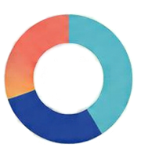
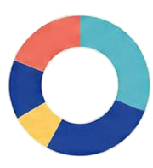







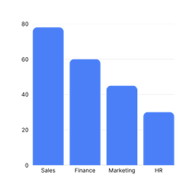


Dashboard — See the Leads at a Glance
Leads Overview
Enquiry Status Breakdown
Enquires By Product Type
Review lead categories
Compare product
requirements and quantities
Info Gaps in leads
Spot records missing details
Use the view to
plan follow-ups

Slide 8


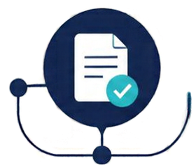
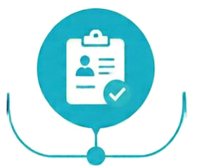




Expected Business Benefits
AI-powered classification and automation create value across your sales process.
Less
repetitive
manual
sorting
More
consistent
lead
records
Clearer
customer
requirements
Missing
details are
easier to
spot
Follow-up
planning
becomes
simpler
Sales
decisions
have better-organized information

Slide 9

















Conclusion —
From Enquiry to Action
1. ENQUIRY
2. AUTOMATION
3. CLASSIFICATION
4. STRUCTURED LEADS
5. FOLLOW-UP
Customer enquiries
arrive from
multiple sources.
n8n coordinates
the end-to-end
workflow.
Python applies custom processing. LLM classifies
enquiry text.
Google Sheets
stores and
organizes leads.
Clean leads appear
in the dashboard
and are ready for
sales follow-up.
Thank You

